Slide 1

Introduction to DBMS & SQL

Slide 2

Outline
What is a database?
What is a DBMS?
What is SQL?
Example Database
Basics of SQL & Practice

Slide 3
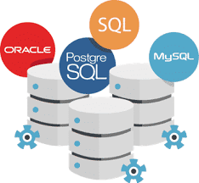
What is a database?
An organized collection of structured data/information that is stored electronically in a computer system (called a database management system).
There are different types of databases:
Relational Databases
Object-Oriented Databases
NoSQL Databases
A Relational Database is composed of multiple “tables” modeled in rows and columns to make processing & querying efficient
Notes:
Relational databases:
--most common type of database
--collection of tables with rows and columns; structured data
--EXAMPLES: MySQL, Oracle, PostgreSQL
NoSQL DB:
--flexible storage of data beyond relational DB
--Examples: MangoDB

Slide 4
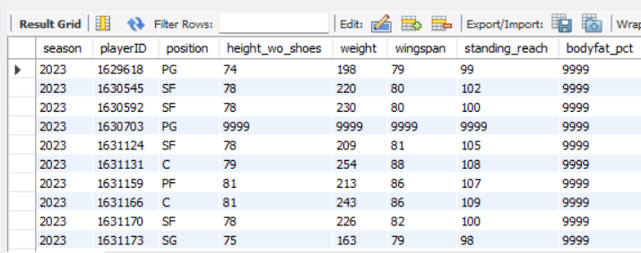
Tables & Terminology
Notes:
Example Table
--Each table should have an attribute or combination of attributes that uniquely identify each row = called a primary key (unique id for each row of a table – ensures that each row is unique)
--Tables can also have foreign keys (helps us figure out the relationships between the tables)
Rows = records (individual entity)
--each row is unique
Columns = collected information, variable called an attribute
Cell = field – single data element, representing one concept

Slide 5
What is a database management system?
DBMS is a software program that serves as an interface between a database and a client/user
DBMS allow a user to create, search, and modify databases.
DBMS Key Features: Data Storage & Retrieval, Data Integrity & Security, Backup & Recovery
Examples of DBMS:
SQL (MySQL Workbench, Microsoft SQL Server, SQLite)
Oracle
MangoDB
dBase
Notes:
Can also write SQL queries in R or Python
Example: A university database can store and manage student information, faculty records, and administrative data, allowing seamless retrieval, insertion, and deletion of information as required.

Slide 6
What is sql?
Structured Query Language
SQL is a programming language used to create, manage, and manipulate relational databases (and sometimes create tables or databases)
SQL became a standard of the American National Standards Institute (ANSI) in 1986, and of the International Organization for Standardization (ISO) in 1987
We would write queries in SQL to interact with databases (we would do this with a specific set of SQL commands)
There are various relational DBMS that use SQL. For example, MySQL, PostgreSQL, Oracle, SQLite, SQL Server.
Notes:
SQL ensures consistency and stability across various database management systems (DBMS).

Slide 7
SQL: Data Definition & Manipulation Language
Commands used to define the structure of the database
CREATE, ALTER, or DROP a database or table within a database.
INSERT, UPDATE, or DELETE a record into a table
Notes:
CREATE – Creates a new table or database
ALTER – Modifies an existing table
DROP – deletes an entire table
INSERT – create a new record in a table
UPDATE – modeifies a record
DELETE – deletes a record

Slide 8
SQL: Data Query language
Different keywords that allow is to retrieve/access records/data within the
Every query will include the SQL keywords – SELECT and FROM
Other population keywords: SELECT DISTINCT, WHERE, GROUP BY, HAVING, AND, OR, NOT, JOIN (INNER JOIN, FULL OUTER JOIN, LEFT JOIN, RIGHT JOIN)
Some aggregate functions we can use: SUM(), AVG(), COUNT(), MIN(), MAX()

Slide 9
References
https://www.oracle.com/database/what-is-database/
https://www.geeksforgeeks.org/what-is-database/
https://www.geeksforgeeks.org/what-is-sql/
https://www.w3schools.com/sql/default.asp
Data from Kaggle (used just to practice writing queries) (https://www.kaggle.com/datasets/wyattowalsh/basketball)
Slides from PHS 7450 class (Professor Jason Lyman)

Slide 10

Thank You
mcf8sr@virginia.edu

